Slide 1
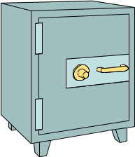

Application of Symmetric Encryption
Plaintext
File encryption
Network encryption
Database encryption
Applications that require encryption of large amount of data.
Encrypt
Ciphertext
Use the SAME key
Ciphertext
Decrypt
Plaintext
* Week 2 Slide 13
ST 2504

Slide 2
The building blocks
from Cryptodome.Cipher import DES
  DES.new(key_bytes,mode)
  DES.encrypt(plain_text_bytes)
  DES.decrypt(encrypted_text_bytes)
from Cryptodome.Random import get_random_bytes
  Get_random_bytes(num_of_bytes)
from Cryptodome.Util.Padding import pad, unpad
  pad(bytes,blocksize, style=pkcs7)
  unpad(bytes, blocksize, style=pkcs7)
ST 2504

Slide 3
PyCryptodome.Random.get_random_bytes
A random bytes generator, can be used to generate secret keys for symmetric algorithms.
Usage
  PyCryptodome.Random.get_random_bytes(N)
    Return a random byte string of length N.
Example
    from Cryptodome.Random import get_random_bytes
    keysize=16
    key=get_random_bytes(keysize)
Further details: https://pycryptodome.readthedocs.io/en/latest/src/random/random.html
ST 2504

Slide 4
PyCryptodome.Cipher
This python package provides the functionality of a cryptographic cipher for encryption and decryption.
To use a Cipher:
  Usage
    Cryptodome.Cipher.<algorithm>.new(key, mode, *args, **kwargs)
  Example
    from Cryptodome.Cipher import DES
    cipher = DES.new(key, DES.MODE_ECB)
Further details: https://pycryptodome.readthedocs.io/en/latest/src/cipher/cipher.html
ST 2504

Slide 5
PyCryptodome.Util.Padding
Cryptodome.Util package provides the Padding module with the functionality for data block padding and unpadding.
To use pad and unpad:
  Usages
    Cryptodome.Util.Padding.pad(data_to_pad, block_size, style='pkcs7')
    Crytodome.Util.Padding.unpad(padded_data, block_size, style='pkcs7')
  Example
    from Cryptodome.Util.Padding import pad, unpad
    text_block=pad(text_in_bytes,32)
Further details: https://pycryptodome.readthedocs.io/en/latest/src/util/util.html
ST 2504

Slide 6
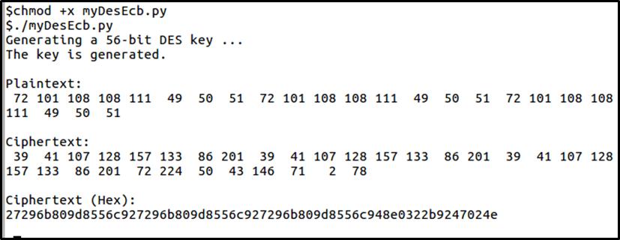
Demo: Symmetric Encryption
Download the program from Black Board
myDesEcb.java
Sample output:
ST 2504

Slide 7
Code Example – myDesEcb.py
#!/usr/bin/env python3
#ST2504 - ACG Practical - myDES_ECB
from Cryptodome.Cipher import DES
from Cryptodome.Random import get_random_bytes
from Cryptodome.Util.Padding import pad, unpad
BLOCK_SIZE = 32
original_text='Hello123Hello123Hello123'
text_in_bytes = original_text.encode() # UTF8 encoded to bytes
print("Generating a 56-bit DES key ...")
key=get_random_bytes(8)
print("The key is generated.\n")
print("Plaintext:")
for b in text_in_bytes:
print("{0:3d}".format(b),end=" ")
print("\n")
cipher = DES.new(key, DES.MODE_ECB)
cipher_text_bytes = cipher.encrypt(pad(text_in_bytes,BLOCK_SIZE))
print("Ciphertext:")
for b in cipher_text_bytes:
print("{0:3d}".format(b),end=" ")
print("\n")
print("Ciphertext (Hex):")
for b in cipher_text_bytes:
print("{0:02x}".format(b),end="")
print("\n")
ST 2504
Notes:
UTF-8 is an important encoding because of the following reasons:
ASCII compatible
easily supported
compact and efficient for most scripts
easily processed, unlike other multibyte encodings

Slide 8

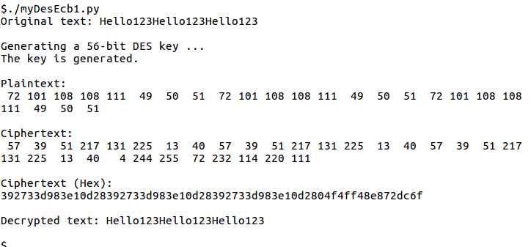
Exercise: Print the Decrypted Message
Attempt to modify the program:
ST 2504

Slide 9
Code Example – myDesEcb.java
#!/usr/bin/env python3
#ST2504 - ACG Practical - myDES_ECB
: : :
"""************************************************
*
* Can you decrypt the message?
*
************************************************/
"""
# create a new DES cipher object with the same key and mode
# Now decrypt the text using your new cipher
# Print the message in UTF8 (normal readable way
ST 2504

Slide 10
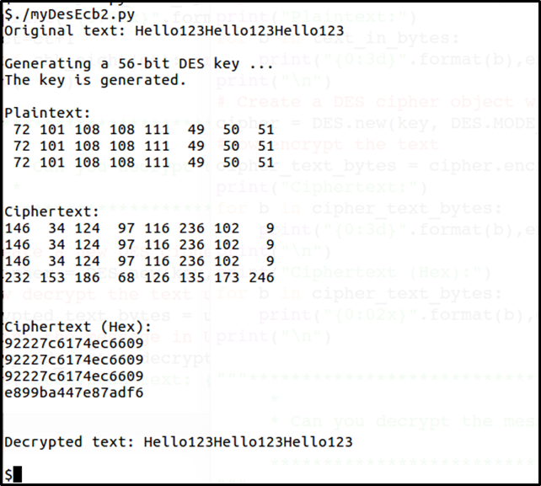
Exercise: Multiple of 8 bytes (64 bits)
Attempt to modify the program:
ST 2504

